Slide 1

Slide 1
Rental Rates and Employment
Team Members:
Randall, Amber, & Josue

Slide 2

Slide 2
Analysis of Housing Rental Market
Question To Answer:
Is there any correlation with rental rate costs with unemployment rate and/or median household income?
What other factors might impact the Rental Market?
2

Slide 3


The Data
U.S. Bureau Of Labor Statistics
3 Datasets selected for evaluation
2 Datasets used for final analysis
Zillow.com
56 Datasets were initially curated from Zillow
14 Datasets selected for inclusion in the data exploration phase
8 Datasets were used for final analysis
We explored the BLS API and pulled some data. However, the API was going to require more custom development than the time was allotted.

Slide 4

Data Exploration (Journey)
Jupyter Notebook was utilized to perform all of the data exploration.
All data was imported into pandas dataframes
Created several visualizations in the initial process to get a feel of the data
The data was from 2013 – 2018 at the City level. Except Unemployment and Median Income was at the State level
We made the decision to aggregate everything to a common dataset by Year, Month and Quarter for the analysis
Additional data was retained at city level and outside the year range for further analysis opportunities

Slide 5

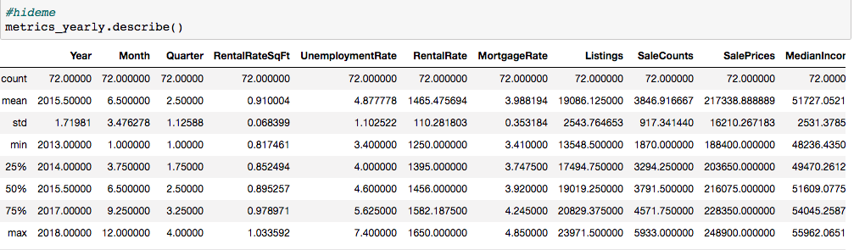
Follow The Data (Analysis)
All data was curated into a single dataframe, then we were able to apply multiple visualization.

Slide 6
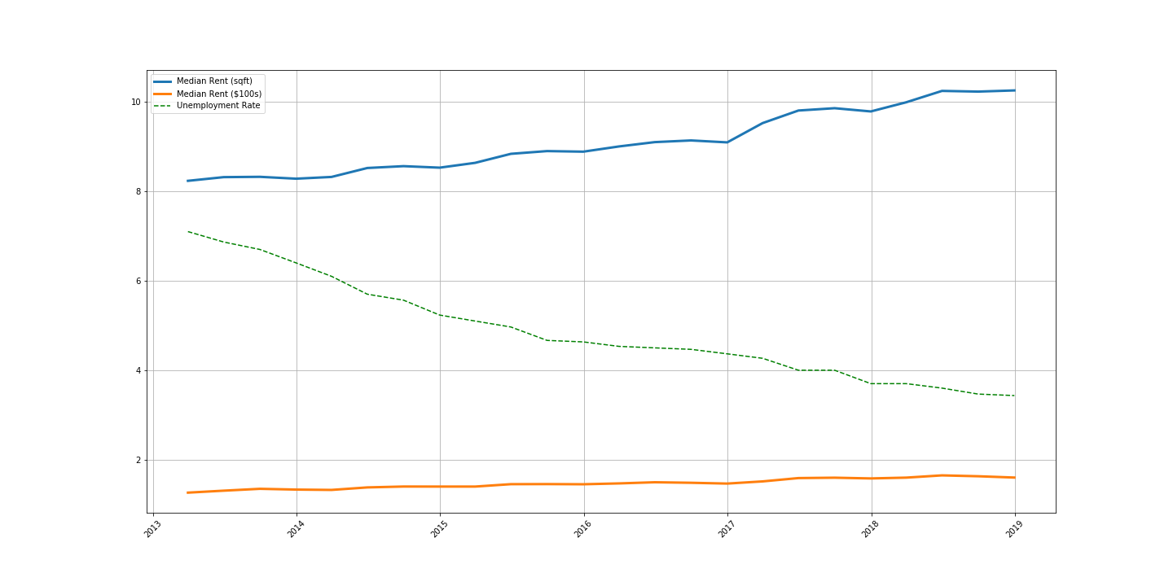
Follow The Data (Analysis)
Started with the core questions by plotting RentalRateSqFt as our primary metric against Unemployment and Median Income
Rental Rates vs Unemployment by Year
Rental Rates
2013 – $1,300
2018 – $1,600 (23% increase)
Unemployment Rate
2013 – 6.2%
2018 – 3.5% (77% decrease)

Slide 7
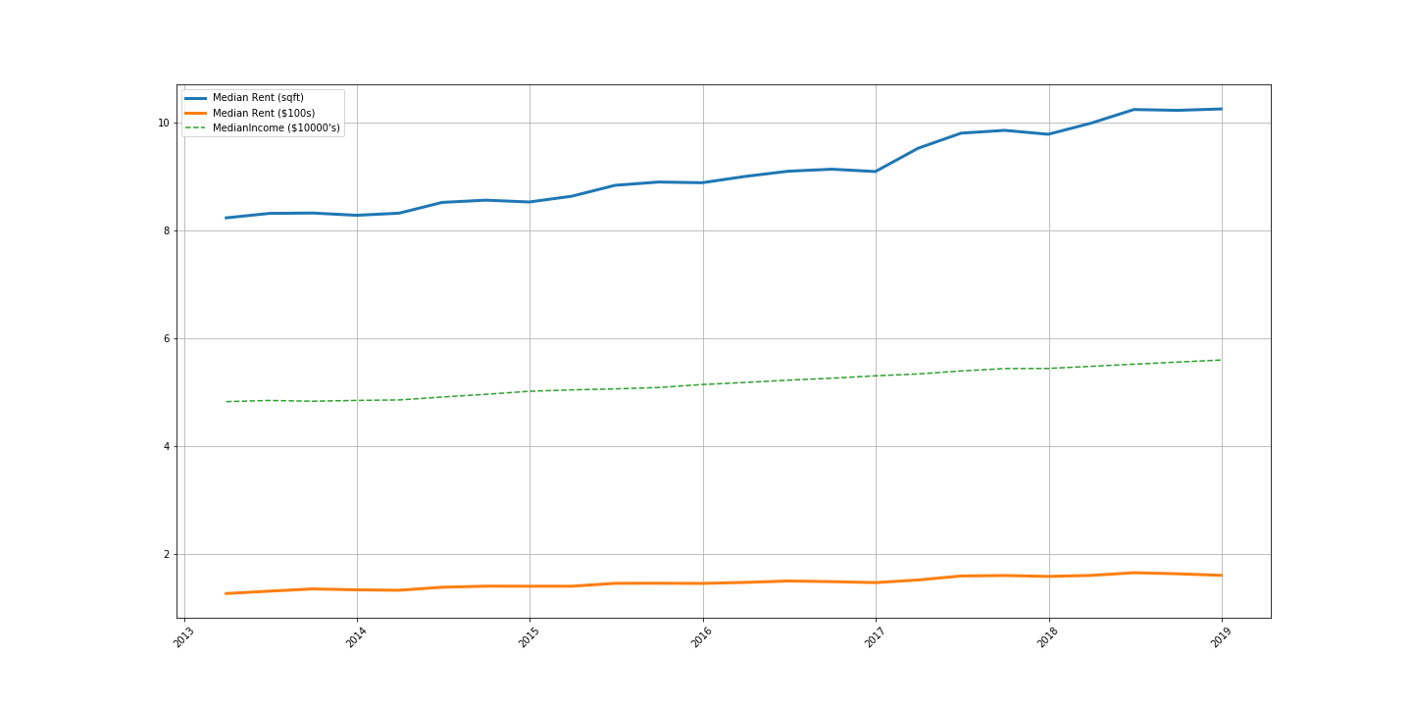
Follow The Data (Analysis)
Rental Rates vs Median Income by Year
Rental Rates
2013 – $1,300
2018 – $1,600 (23% increase)
Median Income
2013 – $48,236
2018 – $55,962 (16% increase)

Slide 8
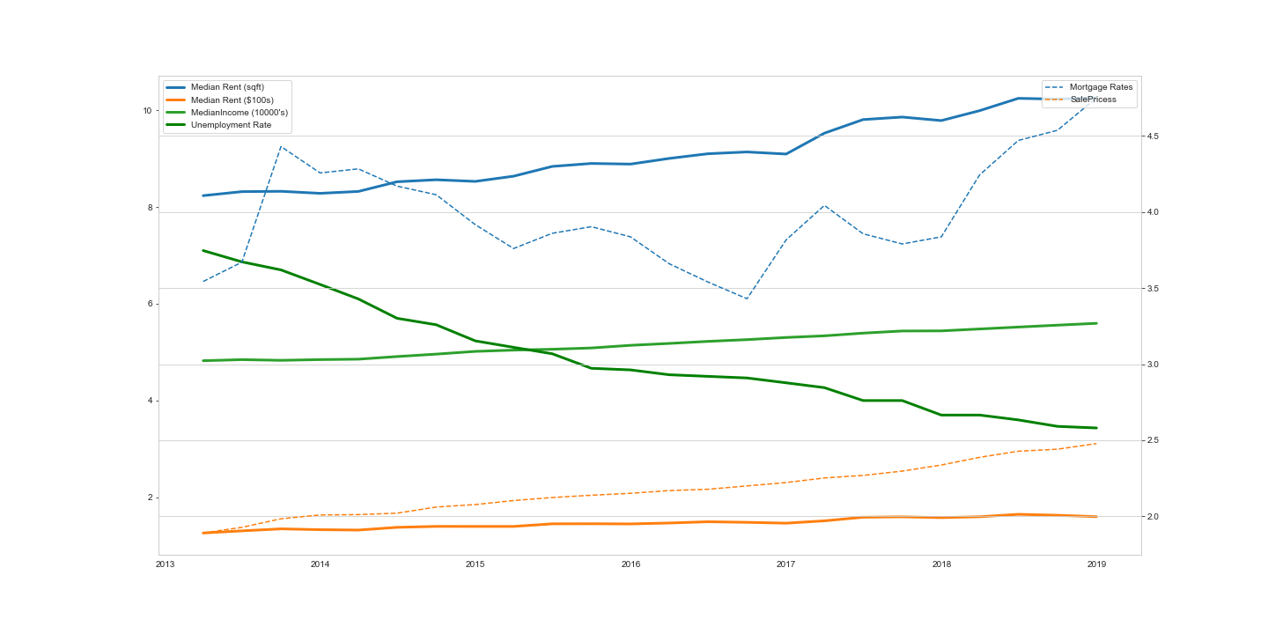
Follow The Data (Analysis)
Plotted all data together
Rental Rates vs All Observations
Rental Rates
2013 – $1,300
2018 – $1,600 (23% increase)
Median Income
2013 – $48,236
2018 – $55,962 (16% increase)
Unemployment Rate
2013 – 6.2%
2018 – 3.5% (77% decrease)
Mortgage Rates
2013 – 3.46%
2018 – 4.6%
Sale Prices
2013 - $189,500
2018 - $248,900 (31% increase)

Slide 9
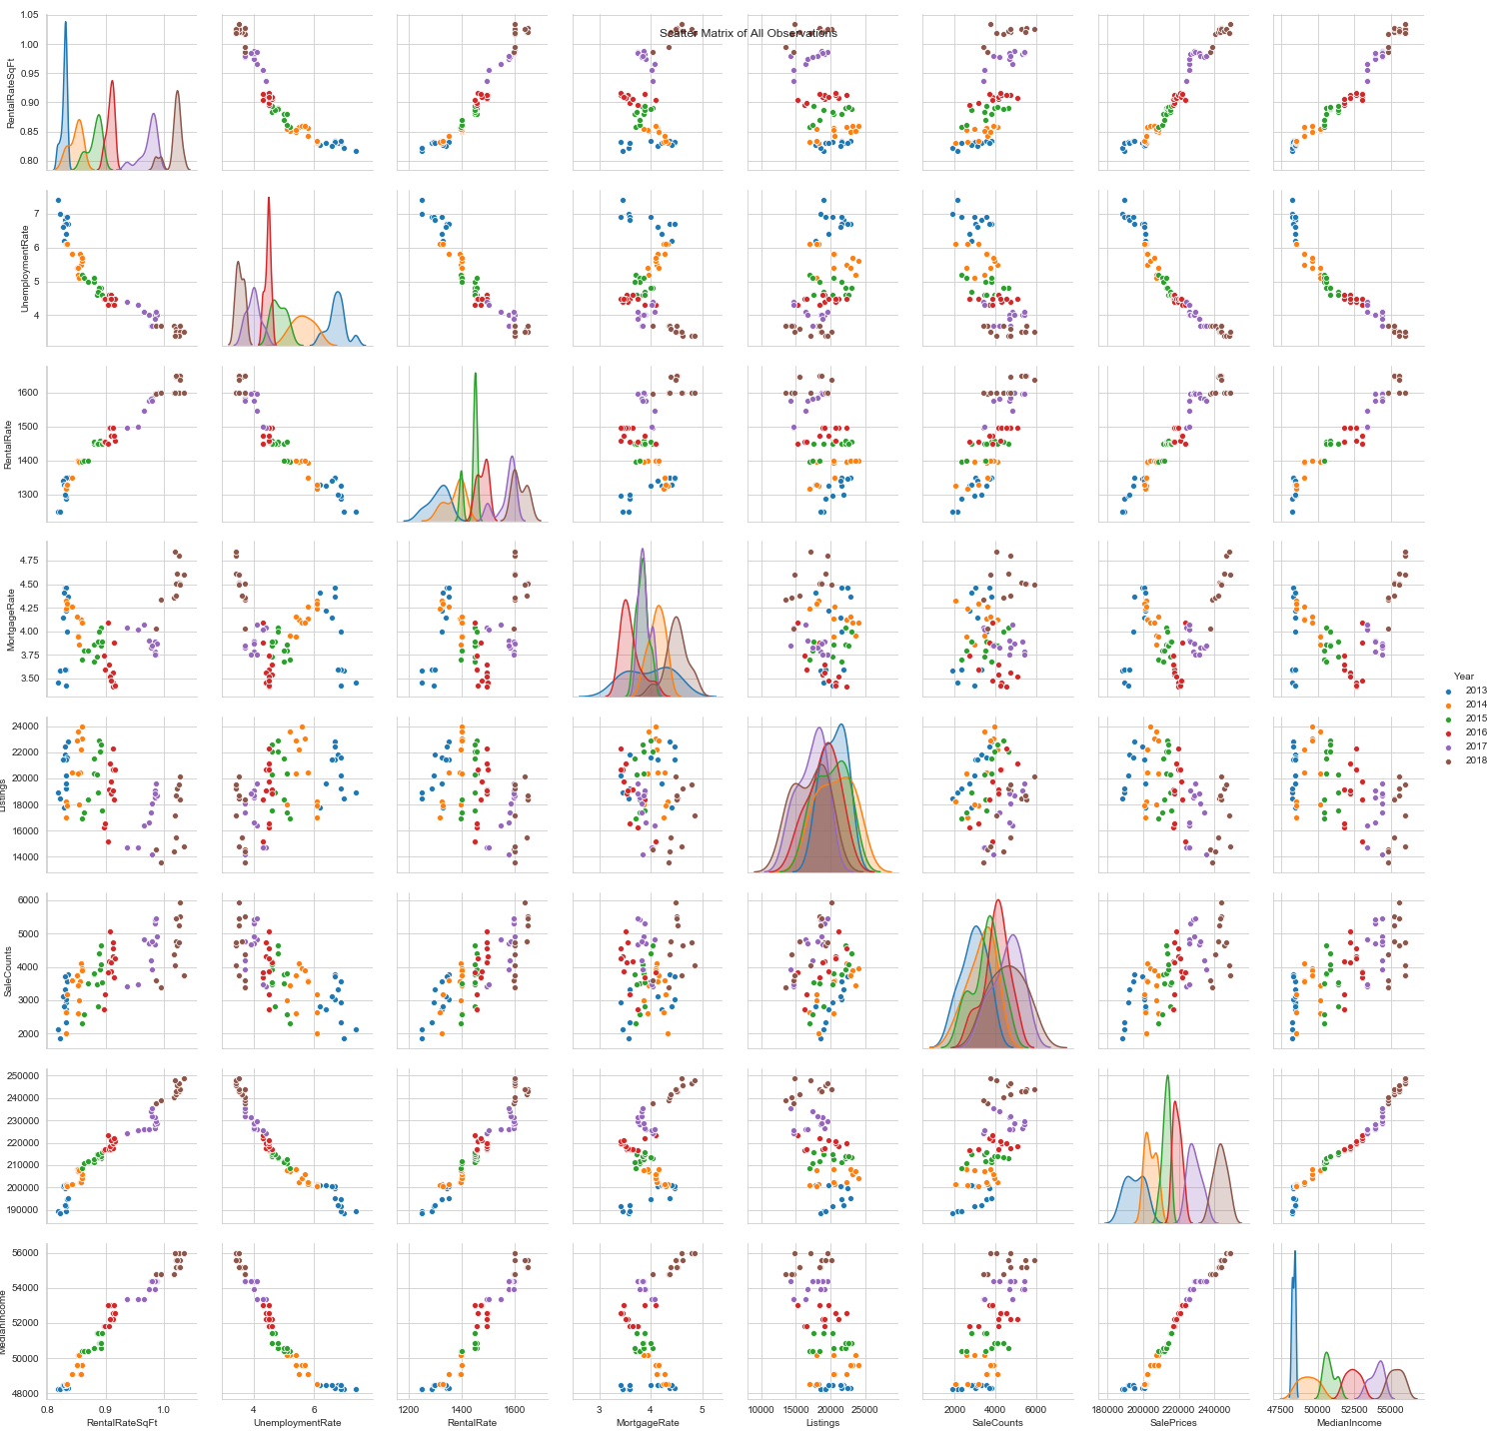
Follow The Data (Analysis)
Scatter Matrix was then plotted across all observations to look for clear signals

Slide 10
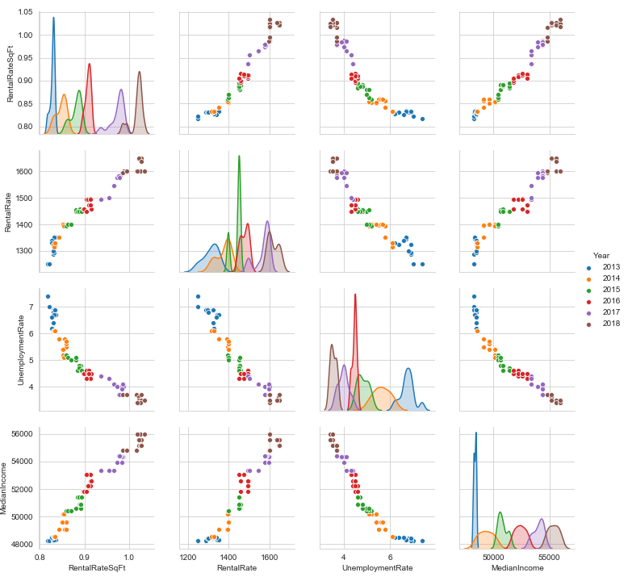
Follow The Data (Analysis)
Scatter Matrix focused on our core metrics

Slide 11
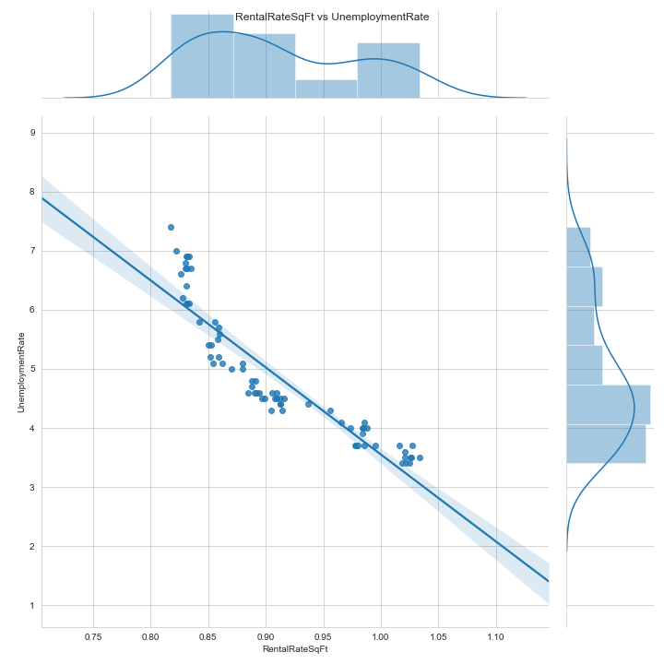
Follow The Data (Analysis)
RentalRateSqFt vs UnemploymentRate - Regression
Jointplot with regression to provide additional support to our finding

Slide 12
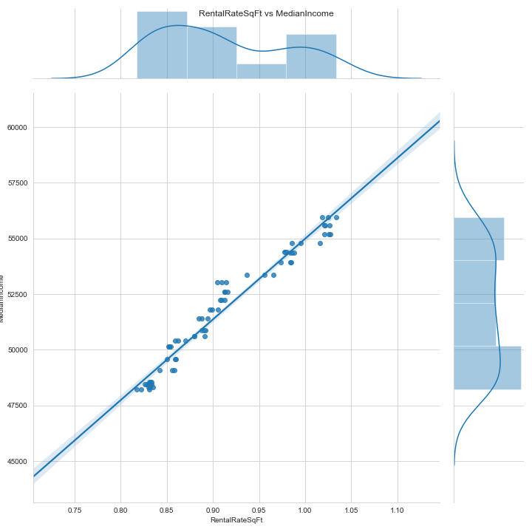
Follow The Data (Analysis)
RentalRateSqFt vs MedianIncome - Regression
Jointplot with regression to provide additional support to our finding

Slide 13
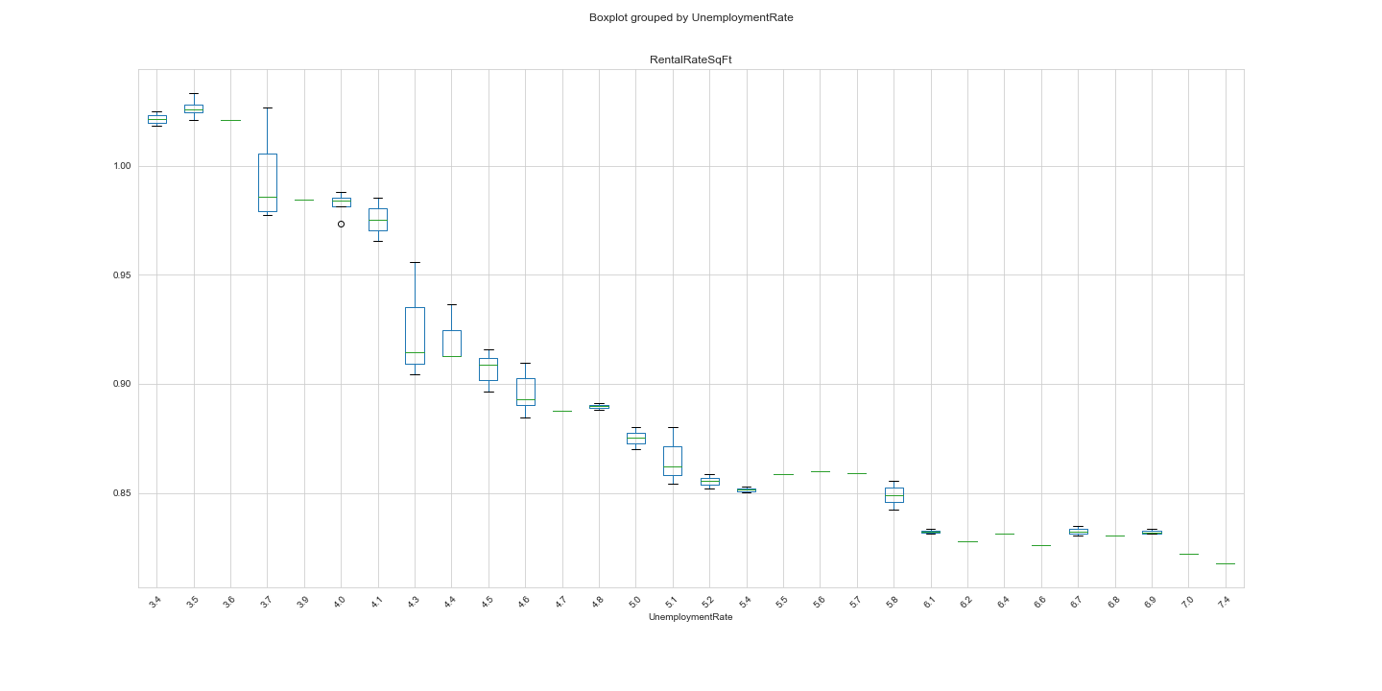
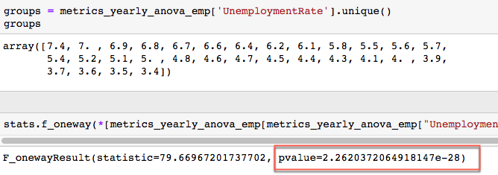
ANOVA Testing of Hypothesis
Null Hypothesis “Unemployment Rates has no correlation to Rental Rates”

Slide 14
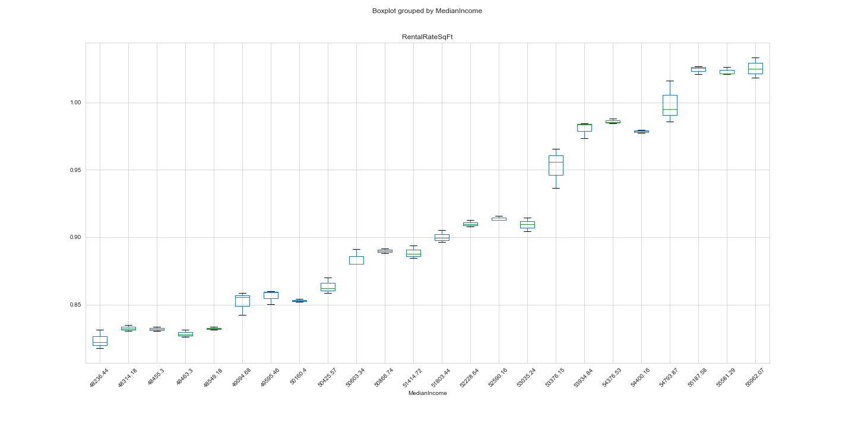
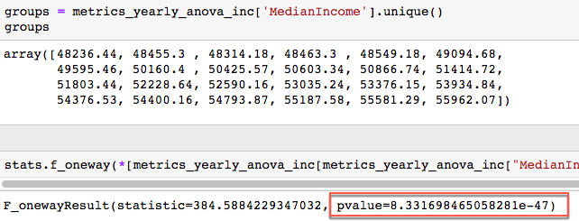
ANOVA Testing of Hypothesis
Null Hypothesis “Median Income has no correlation to Rental Rates”

Slide 15

Slide 2
Conclusion
As unemployment rates decrease the rental rate per SqFt. increases
As median income increases so does rental rate per SqFt.
By looking at the additional data (mortgage rates and home inventory), it shows the supply and demand as to why home prices increased
Since it is making difficult for individuals to afford and purchase a home, they are renting longer. This increases the demand to rent, while the supply of rentals decreases
2

Slide 16

Questions

Slide 17
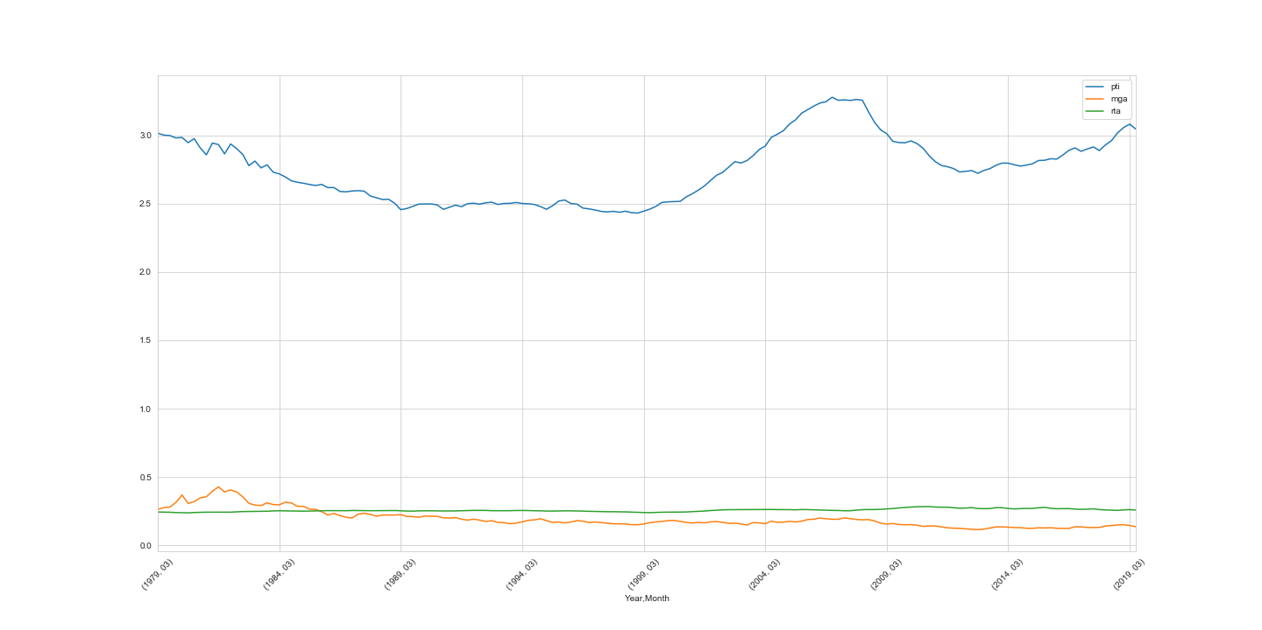
Additional Observations – Affordability Index
Mortgage Affordability, Rental Affordability, Price-to-Income Ratio, and Household Income are calculated as a part of Zillow’s quarterly Affordability Indices. To calculate mortgage affordability, we first calculate the mortgage payment for the median-valued home in a metropolitan area by using the metro-level Zillow Home Value Index for a given quarter and the 30-year fixed mortgage interest rate during that time period, provided by the Freddie Mac Primary Mortgage Market Survey (based on a 20 percent down payment). Then, we consider what portion of the monthly median household income (U.S. Census) goes toward this monthly mortgage payment. Median household income is available with a lag. For quarters where median income is not available from the U.S. Census Bureau, we calculate future quarters of median household income by estimating it using the Bureau of Labor Statistics’ Employment Cost Index. The affordability forecast is calculated similarly to the current affordability index but uses the one year Zillow Home Value Forecast instead of the current Zillow Home Value Index and a specified interest rate in lieu of PMMS. It also assumes a 20 percent down payment. We calculate rent affordability similarly to mortgage affordability; however we use the Zillow Rent Index, which tracks the monthly median rent in particular geographical regions, to capture rental prices.

Slide 18
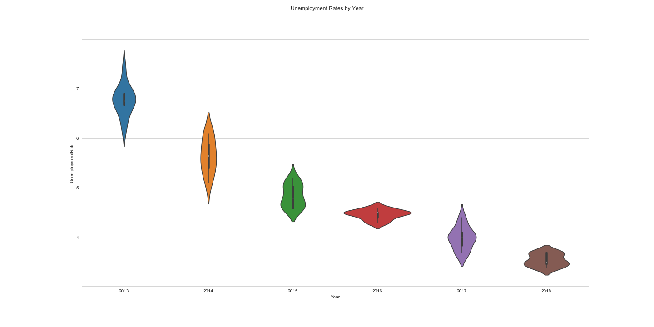
Unemployment Rates by Year – Violin Plots

Slide 19
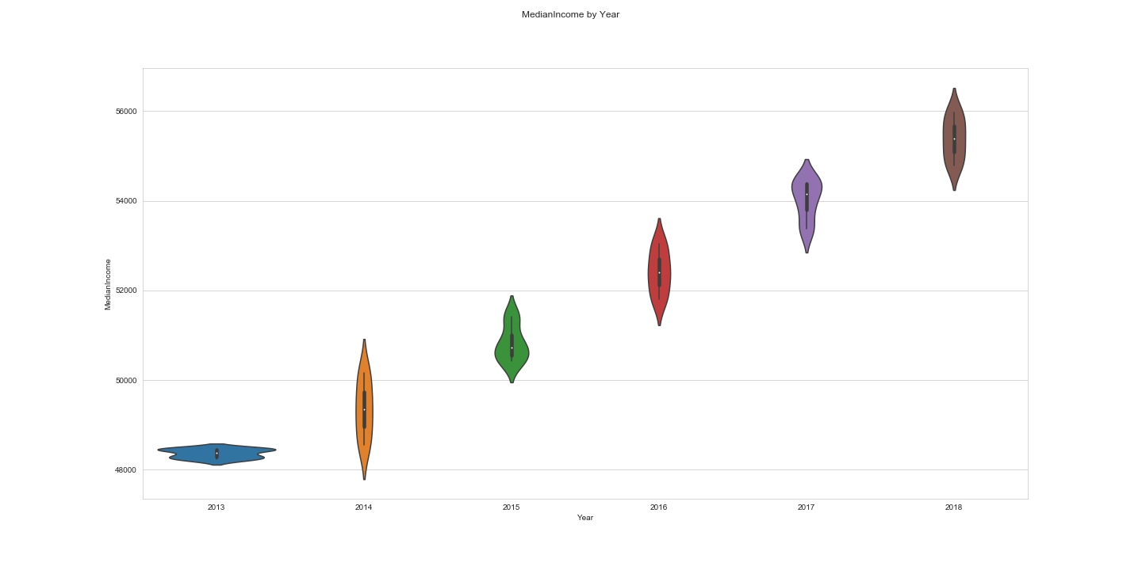
Median Income by Year – Violin Plots

Slide 20
Interactive Layerd Maps

Slide 21
Interactive Layerd Maps

Slide 22
Interactive Layerd Maps

